Slide 1


Slide 2
Introduction To Data Analyst And Data Science For Beginners
Lecture # 0
Overview Of COURSE
Ehtisham Sadiq

Slide 3


Today’s Agenda
What is Data Analyst?
What is Data Science?
Difference between data science and data analyst?
Course Information and Protocols
Tools and Techniques
Salary Description
Syllabus Design
Python Installation
Study Material
Contact Details

Slide 4
What is Data Analyst?
A data analyst collects, cleans, and interprets data sets in order to answer a question or solve a problem. They can work in many industries, including business, finance, criminal justice, science, medicine, and government.
Data Analyst is an entry level member into the data analytics team
Needs to have good technical skills and know the basics of statistics, data munging, data utilization, and exploratory data analysis
Can move to the role of Data engineer and Data scientist with more experience

Slide 5

What is Data Science?
Data science is the field of study that combines domain expertise, programming skills, and knowledge of mathematics and statistics to extract meaningful insights from data.
Senior most in the team and take inputs from the rest to formulate actionable insight for the business
Makes use of the latest tools and technologies in finding solutions and reaching conclusions that are crucial for an organization’s growth and development

Slide 6
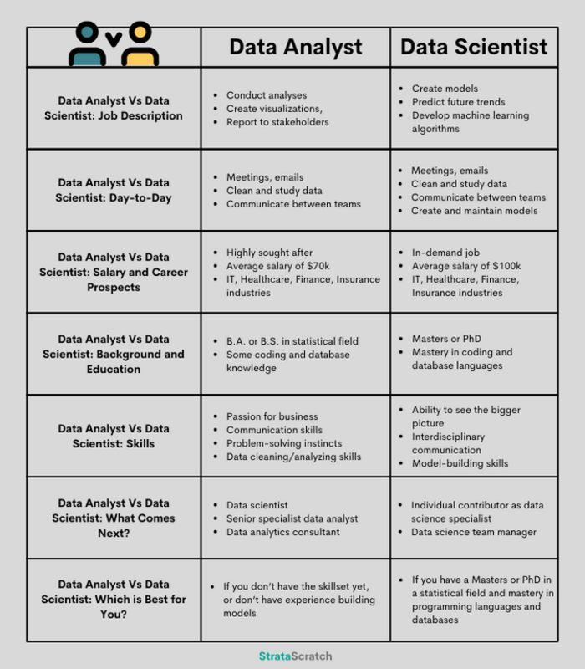
Data Analyst vs Data Science

Slide 7

Tools and Technologies
Skill Set
Statistics
Programming Languages
Data Extraction
Data Preprocessing
Data Exploration
Data Visualization
Machine Learning
Big Data

Slide 8
Tools and Technologies (Cont.)
Programming Languages
Python Programming
NumPy
Pandas
Scikit-Learn
Seaborn
Matplotlib etc
R Programming
Tools
Excel (Basic to advance)

Slide 9
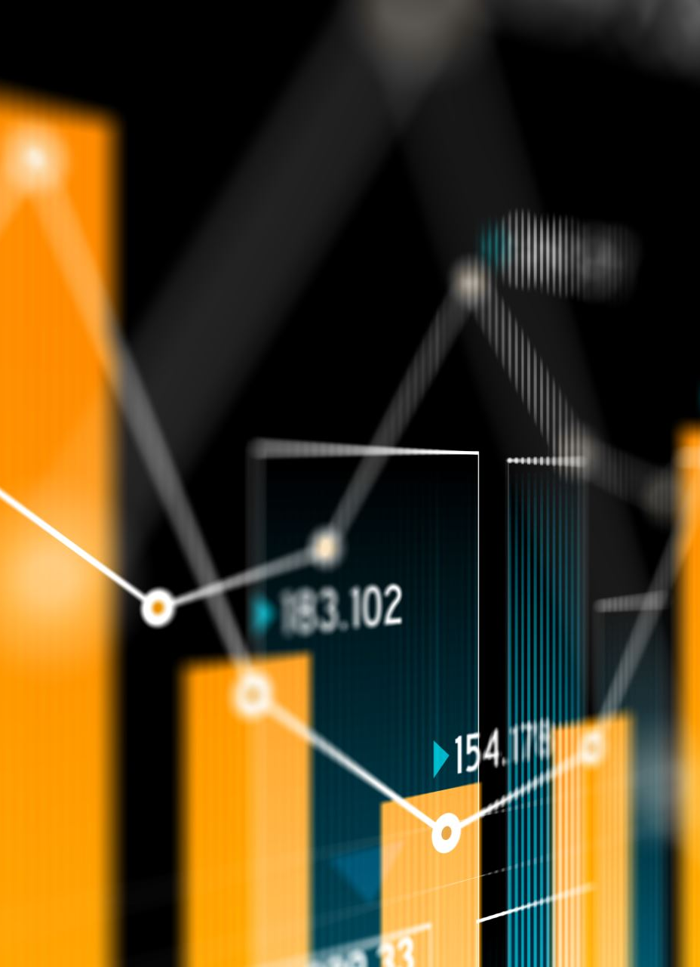
Tools and Technologies(Cont.)
Technologies
Descriptive Statistics
Inferential Statistics
Simple Regression
Linear Regression
Multiple Regression
Classification Algorithms
Logistic Regression
Decision Tree
Random Forest
Clustering Algorithms
K –Means
Hierarchical Clustering

Slide 10
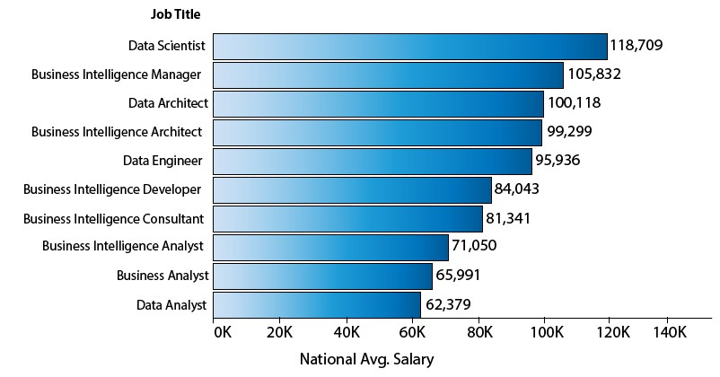
Salary Description

Slide 11

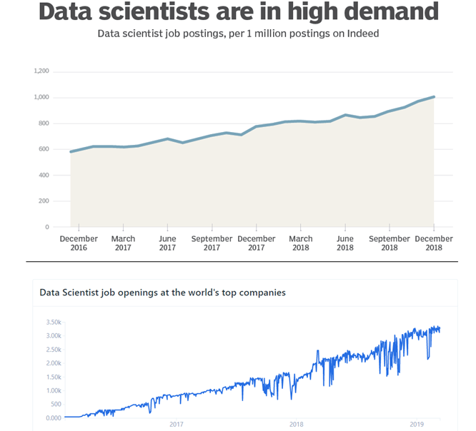



Job Demands

Slide 12

Syllabus Design
Module # 1
Python Programming Language
Python Basics
List
Set
Tuples
Dictionary
Function, etc.
Projects

Slide 13
Syllabus Design
Module # 2
Git & GitHub
LinkedIn Profile
Module # 3
MS Excel
Excel Sheet
Excel Calculation
Excel Formulas
File Handling
Excel If Condition

Slide 14
Syllabus Design (Cont.)
Module # 4
Data Preprocessing
Data quality assessment
Data cleaning
Data transformation
Data reduction
Module # 5
Data Visualization
Matplotlib
Seaborn

Slide 15

Syllabus Design (Cont.)
Module # 6
Mathematics
Linear Algebra
Analytic Geometry
Matrix
Vector Calculus
Optimization
Regression
Dimensionality Reduction
Density Estimation
Classification

Slide 16

Syllabus Design (Cont.)
Probability
Introduction to Probability
1D Random Variable
The function of One Random Variable
Joint Probability Distribution
Discrete Distribution
Binomial (Python )
Bernoulli
Geometric etc
Continuous Distribution
Uniform
Exponential
Gamma
Normal Distribution (Python )

Slide 17

Syllabus Design (Cont.)
Statistics
Data Description
Random Samples
Sampling Distribution
Parameter Estimation
Hypotheses Testing (Python )
ANOVA (Python )
Simple Linear Regression
Correlation
Multiple Regression (Python )
Nonparametric Statistics
Statistical Quality Control
Basics of Graphs

Slide 18

Syllabus Design (Cont.)
Machine Learning
How Model Works
Basic Data Exploration
First ML Model
Model Validation
Underfitting & Overfitting
Random Forests (Python )
Handling Missing Values
Handling Categorical Variables
Pipelines
Cross-Validation
Data Leakage

Slide 19
Final Projects and Resume
Fake News Detection
Build a Chatbots
Recommendation System
Driver Drowsiness Detection
Sentiment Analysis
Credit Card Fraud Detection Project
Road Lane line detection
Color Detection with Python
Stock Price Predictor
Forest Fire Prediction

Slide 20
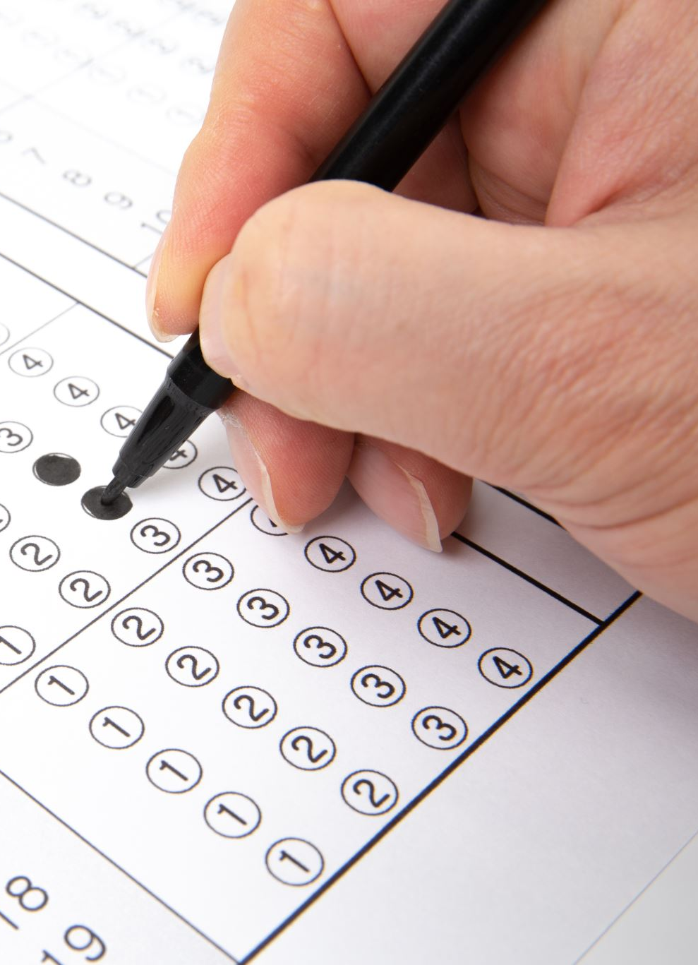
Course Information and Protocols
Duration : 1-Year
Number of lectures in a week : 3 Lectures
2 Lectures for Field Knowledge
Monday and Thursday(3:00 pm – 4:30pm)
1 Lecture for Skills
Saturday (2:00 pm – 3:00pm)
Assignments and Quizzes
One Per Week

Slide 21

Course Material
Google Class using email addresses
Telegram Group

Slide 22

Python Installation
Python3
Jupyter-notebook

Slide 23
Contact
raiehtisham786@gmail.com
Telegram Group

Slide 24


